Slide 1
Chapter 2
Console Input and Output

Slide 2
System.out.println for console output
System.out is an object that is part of the Java language
println is a method invoked by the System.out object that can be used for console output
  The data to be output is given as an argument in parentheses
  A plus sign is used to connect more than one item
  Every invocation of println ends a line of output
    System.out.println("The answer is " + 42);
© 2006 Pearson Addison-Wesley. All rights reserved
2-<number>

Slide 3
println Versus print
Another method that can be invoked by the System.out object is print
The print method is like println, except that it does not end a line
  With println, the next output goes on a new line
  With print, the next output goes on the same line
© 2006 Pearson Addison-Wesley. All rights reserved
2-<number>

Slide 4
Formatting Output with printf
Starting with version 5.0, Java includes a method named printf that can be used to produce output in a specific format
The Java method printf is similar to the print method
  Like print, printf does not advance the output to the next line
System.out.printf can have any number of arguments
  The first argument is always a format string that contains one or more format specifiers for the remaining arguments
  All the arguments except the first are values to be output to the screen
© 2006 Pearson Addison-Wesley. All rights reserved
2-<number>

Slide 5
printf Format Specifier
The code
  double price = 19.8;
  System.out.print("$");
  System.out.printf("%6.2f", price);
  System.out.println(" each");
will output the line
  $ 19.80 each
The format string "%6.2f" indicates the following:
  End any text to be output and start the format specifier (%)
  Display up to 6 right-justified characters, pad fewer than six characters on the left with blank spaces (i.e., field width is 6)
  Display exactly 2 digits after the decimal point (.2)
  Display a floating point number, and end the format specifier (i.e., the conversion character is f)
© 2006 Pearson Addison-Wesley. All rights reserved
2-<number>

Slide 6
Right and Left Justification in printf
The code
    double value = 12.123;
    System.out.printf("Start%8.2fEnd", value);
    System.out.println();
    System.out.printf("Start%-8.2fEnd", value);
    System.out.println();
  will output the following
    Start 12.12End
    Start12.12 End
The format string "Start%8.2fEnd" produces output that is right justified with three blank spaces before the 12.12
The format string "Start%-8.2fEnd" produces output that is left justified with three blank spaces after the 12.12
© 2006 Pearson Addison-Wesley. All rights reserved
2-<number>

Slide 7
Multiple arguments with printf
The following code contains a printf statement having three arguments
  The code
    double price = 19.8;
    String name = "magic apple";
    System.out.printf("$%6.2f for each %s.",
    price, name);
    System.out.println();
    System.out.println("Wow");
  will output
    $ 19.80 for each magic apple.
    Wow
  Note that the first argument is a format string containing two format specifiers (%6.2f and %s)
  These format specifiers match up with the two arguments that follow (price and name)
© 2006 Pearson Addison-Wesley. All rights reserved
2-<number>

Slide 8
Line Breaks with printf
Line breaks can be included in a format string using %n
The code
    double price = 19.8;
    String name = "magic apple";
    System.outprintf("$%6.2f for each %s.%n", price, name);
    System.out.println("Wow");
will output
    $ 19.80 for each magic apple.
    Wow
© 2006 Pearson Addison-Wesley. All rights reserved
2-<number>

Slide 9
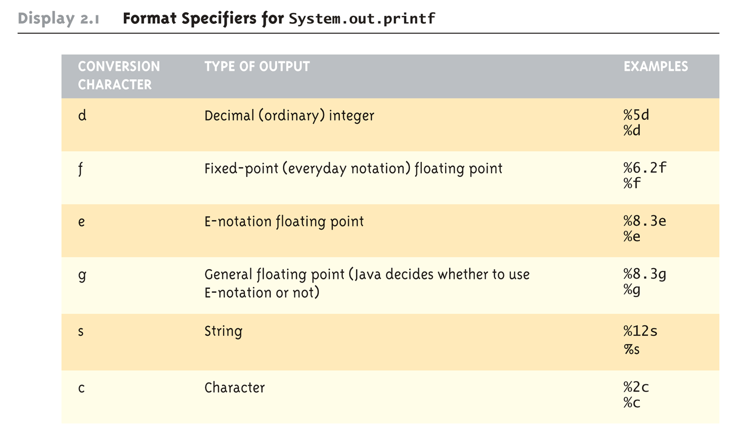
Format Specifiers for System.out.printf
© 2006 Pearson Addison-Wesley. All rights reserved
2-<number>

Slide 10
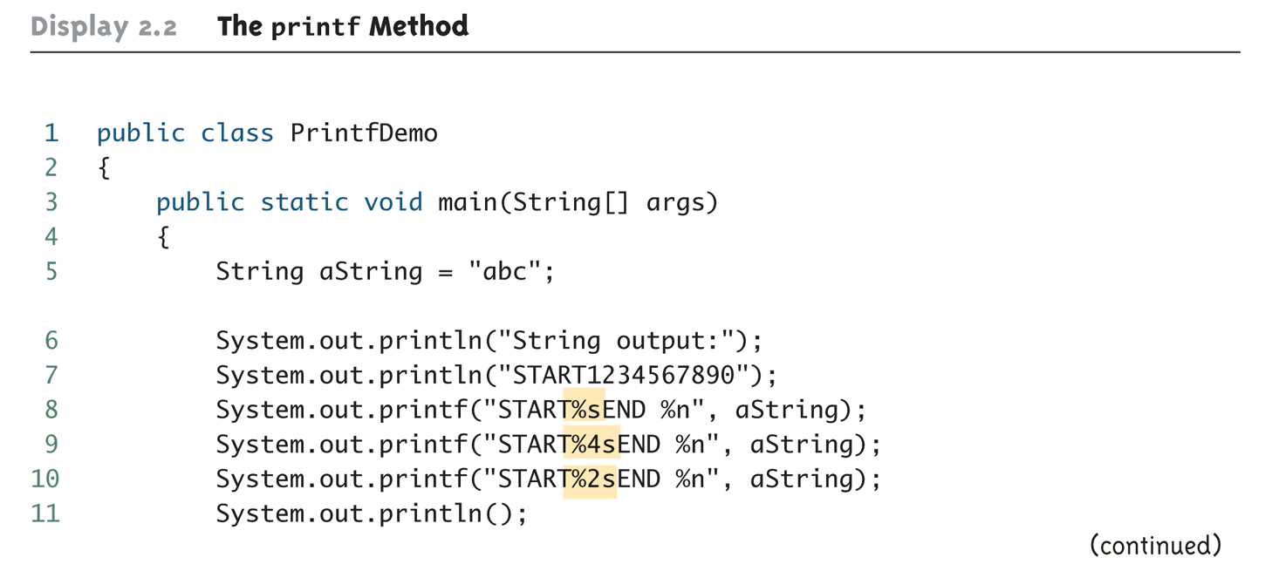
The printf Method (Part 1 of 3)
© 2006 Pearson Addison-Wesley. All rights reserved
2-<number>

Slide 11
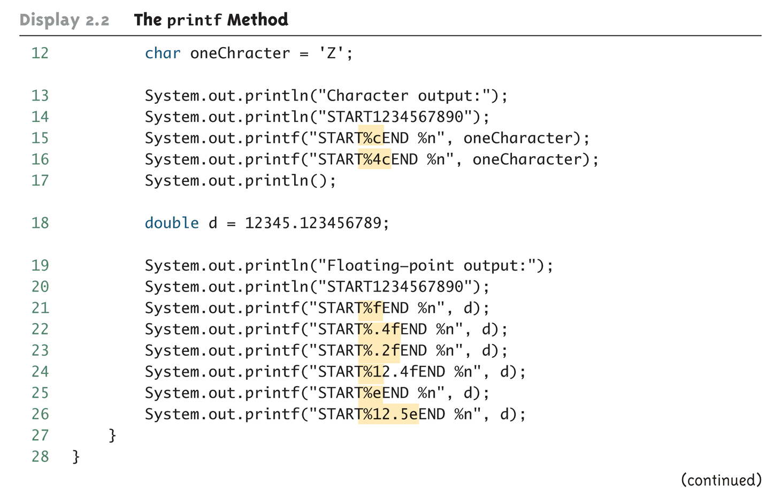
The printf Method (Part 2 of 3)
© 2006 Pearson Addison-Wesley. All rights reserved
2-<number>

Slide 12
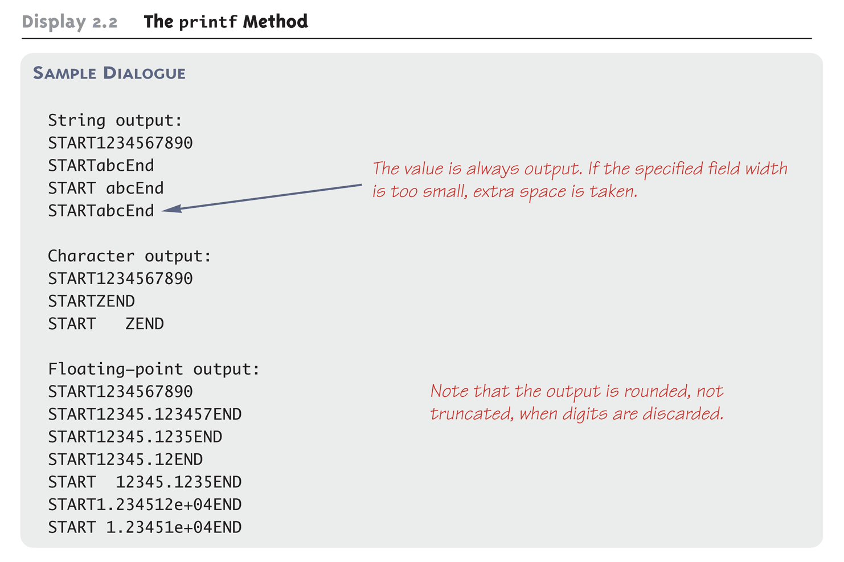
The printf Method (Part 3 of 3)
© 2006 Pearson Addison-Wesley. All rights reserved
2-<number>

Slide 13
Formatting Money Amounts with printf
A good format specifier for outputting an amount of money stored as a double type is %.2f
It says to include exactly two digits after the decimal point and to use the smallest field width that the value will fit into:
  double price = 19.99;
  System.out.printf("The price is $%.2f each.")
produces the output:
  The price is $19.99 each.
© 2006 Pearson Addison-Wesley. All rights reserved
2-<number>

Slide 14
Legacy Code
Code that is "old fashioned" but too expensive to replace is called legacy code
Sometimes legacy code is translated into a more modern language
The Java method printf is just like a C language function of the same name
This was done intentionally to make it easier to translate C code into Java
© 2006 Pearson Addison-Wesley. All rights reserved
2-<number>

Slide 15
Money Formats
Using the NumberFormat class enables a program to output amounts of money using the appropriate format
  The NumberFormat class must first be imported in order to use it
    import java.text.NumberFormat
  An object of NumberFormat must then be created using the getCurrencyInstance() method
  The format method takes a floating-point number as an argument and returns a String value representation of the number in the local currency
© 2006 Pearson Addison-Wesley. All rights reserved
2-<number>

Slide 16
Money Formats
import java.text.NumberFormat;
public class CurrencyFormatDemo
{
public static void main(String[] args)
{
System.out.println("Default location:");
NumberFormat moneyFormater =
NumberFormat.getCurrencyInstance();
System.out.println(moneyFormater.format(19.8));
System.out.println(moneyFormater.format(19.81111));
System.out.println(moneyFormater.format(19.89999));
System.out.println(moneyFormater.format(19));
System.out.println();
}
}
© 2006 Pearson Addison-Wesley. All rights reserved
2-<number>

Slide 17
Money Formats
Output of the previous program
  Default location:
  $19.80
  $19.81
  $19.90
  $19.00
© 2006 Pearson Addison-Wesley. All rights reserved
2-<number>

Slide 18
Specifying Locale
Invoking the getCurrencyInstance() method without any arguments produces an object that will format numbers according to the default location
In contrast, the location can be explicitly specified by providing a location from the Locale class as an argument to the getCurrencyInstance() method
  When doing so, the Locale class must first be imported
    import java.util.Locale;
© 2006 Pearson Addison-Wesley. All rights reserved
2-<number>

Slide 19
Specifiying Locale
import java.text.NumberFormat;
import java.util.Locale;
public class CurrencyFormatDemo
{
public static void main(String[] args)
{
System.out.println("US as location:");
NumberFormat moneyFormater2 =
NumberFormat.getCurrencyInstance(Locale.US);
System.out.println(moneyFormater2.format(19.8));
System.out.println(moneyFormater2.format(19.81111));
System.out.println(moneyFormater2.format(19.89999));
System.out.println(moneyFormater2.format(19));
}
}
© 2006 Pearson Addison-Wesley. All rights reserved
2-<number>

Slide 20
Specifying Locale
Output of the previous program
  US as location:
  $19.80
  $19.81
  $19.90
  $19.00
© 2006 Pearson Addison-Wesley. All rights reserved
2-<number>

Slide 21
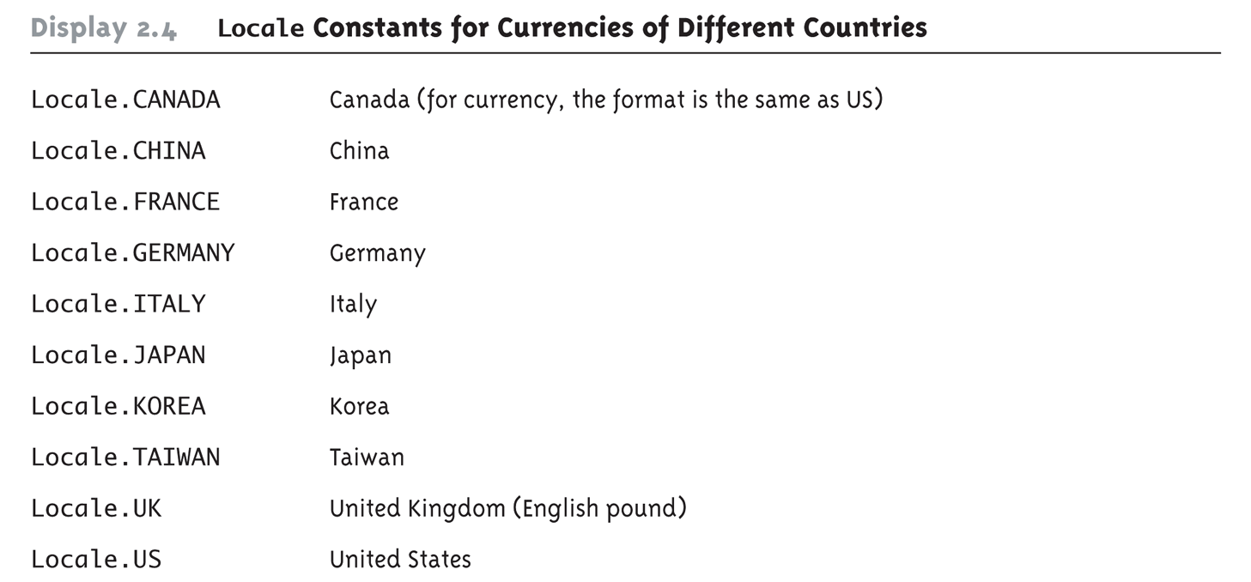
Locale Constants for Currencies of Different Countries
© 2006 Pearson Addison-Wesley. All rights reserved
2-<number>

Slide 22
Importing Packages and Classes
Libraries in Java are called packages
  A package is a collection of classes that is stored in a manner that makes it easily accessible to any program
  In order to use a class that belongs to a package, the class must be brought into a program using an import statement
  Classes found in the package java.lang are imported automatically into every Java program
    import java.text.NumberFormat;
  // import theNumberFormat class only
    import java.text.*;
  //import all the classes in package java.text
© 2006 Pearson Addison-Wesley. All rights reserved
2-<number>

Slide 23
The DecimalFormat Class
Using the DecimalFormat class enables a program to format numbers in a variety of ways
  The DecimalFormat class must first be imported
  A DecimalFormat object is associated with a pattern when it is created using the new command
  The object can then be used with the method format to create strings that satisfy the format
  An object of the class DecimalFormat has a number of different methods that can be used to produce numeral strings in various formats
© 2006 Pearson Addison-Wesley. All rights reserved
2-<number>

Slide 24
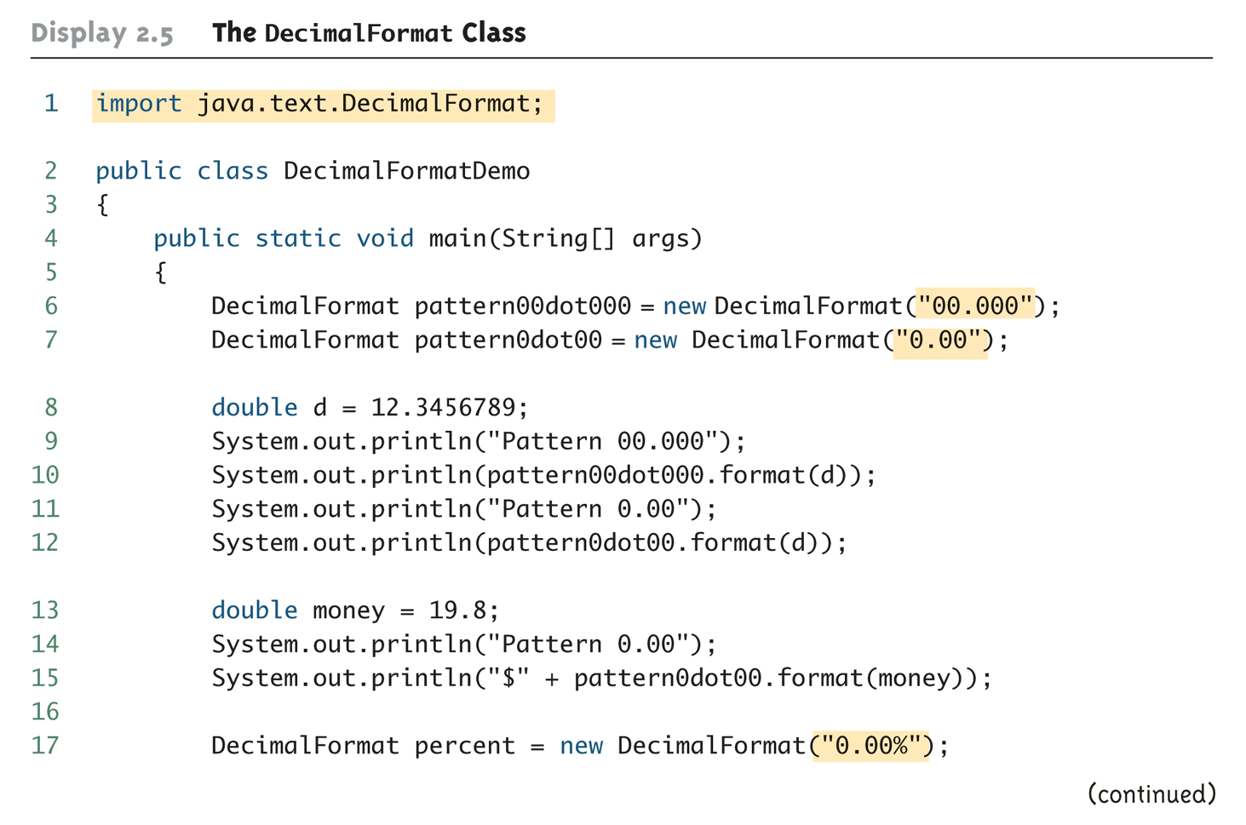
The DecimalFormat Class
(Part 1 of 3)
© 2006 Pearson Addison-Wesley. All rights reserved
2-<number>

Slide 25
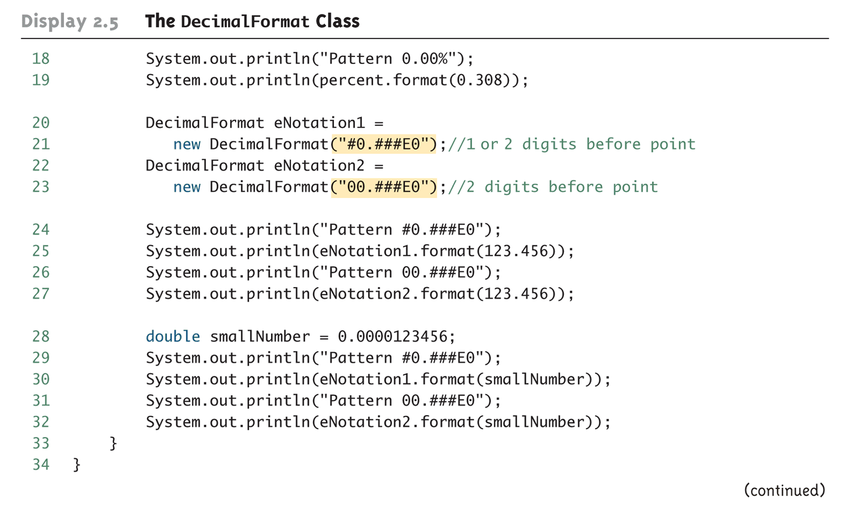
The DecimalFormat Class
(Part 2 of 3)
© 2006 Pearson Addison-Wesley. All rights reserved
2-<number>

Slide 26
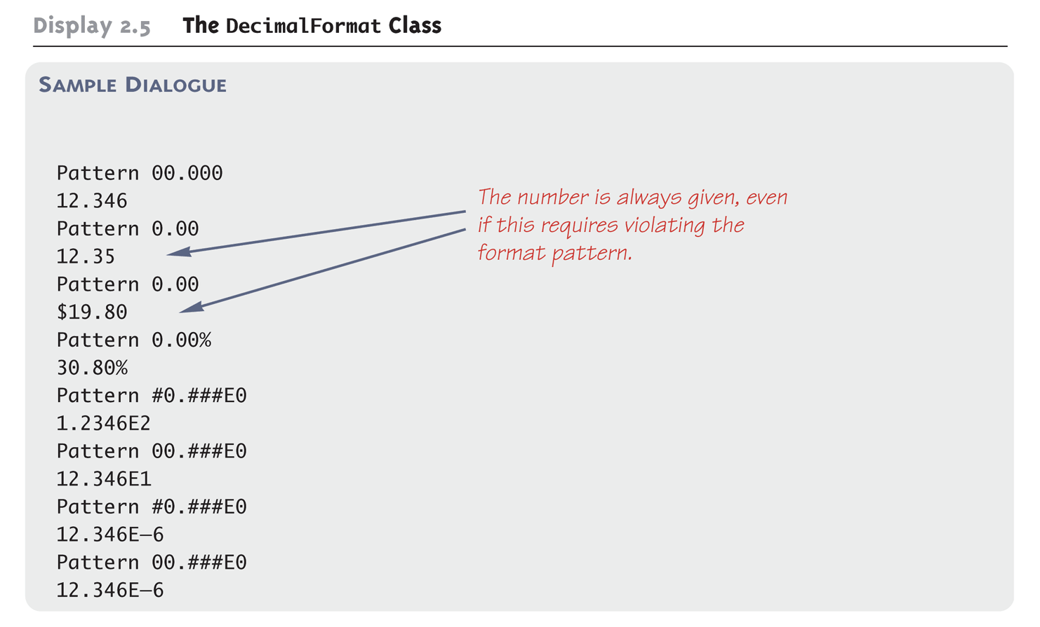
The DecimalFormat Class
(Part 3 of 3)
© 2006 Pearson Addison-Wesley. All rights reserved
2-<number>

